Slide 1
Lessons from Estonia: resolving non-performing loans
Tallinn
November 29, 2017

Slide 2
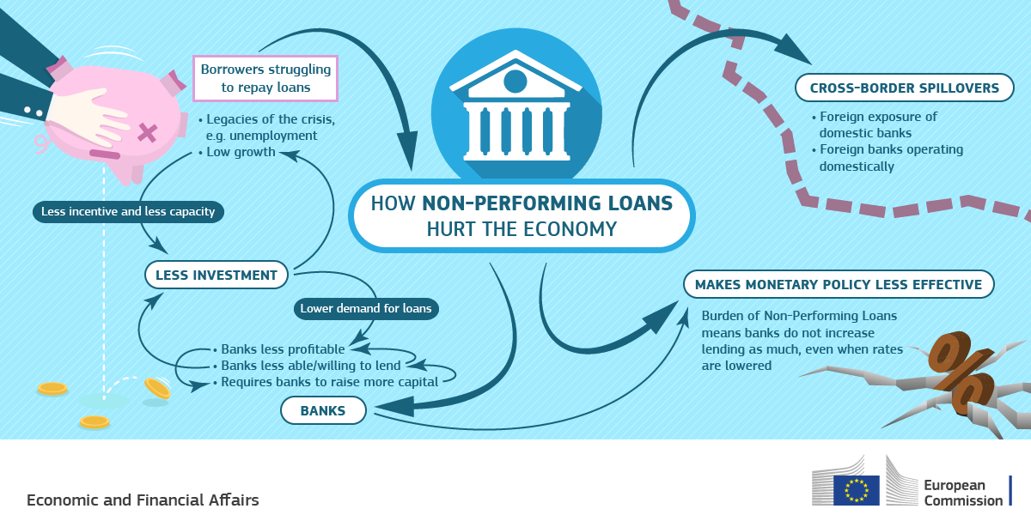
Why is timely resolving of NPLs important?
Banks which are unable to cope with their stock on NPLs struggle to return to profitability
Governance costs: focus on internal processes rather than business development/growth
NPLs lock up capital in non-productive assets
Allikas: Komisjon
Notes:
For example look on Japanese zombie lending in 1990s

Slide 3
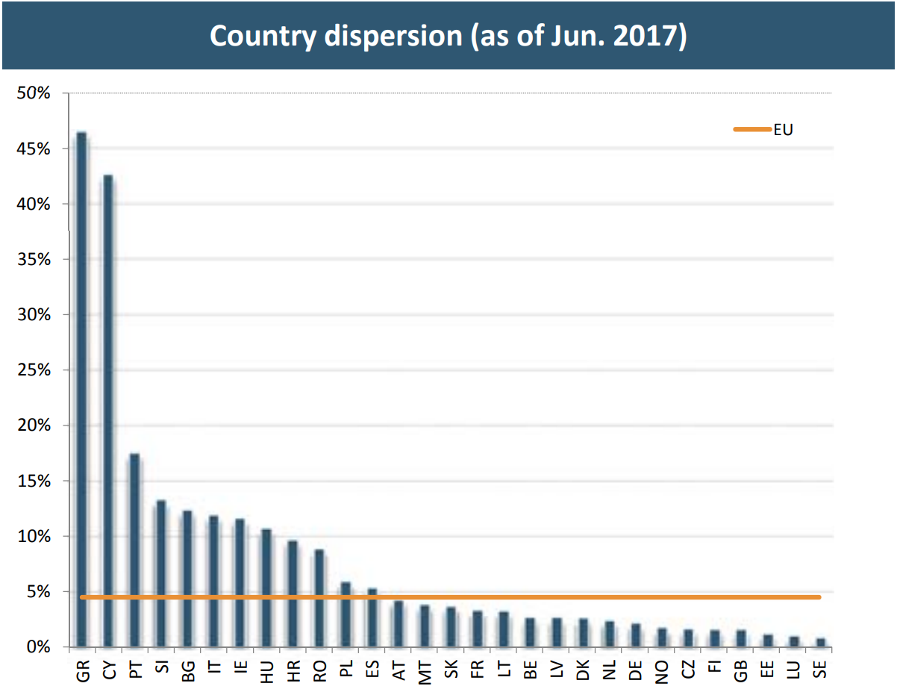
Roughly 1/3 of EU members struggle with excessively high NPL levels
Allikas: EBA

Slide 4
Crisis of 2008-2009 had a severe impact on Estonian economy
GDP maximum contraction was close to 20%, unemployment rose to 20%, real estate prices fell 51% for some properties*
* m2 price in two-room apartments, all regions

Slide 5
Drastic economic conditions led to quick build-up of non-performing loans

Slide 6
Sectors connected to real estate were affected the most
All major sectors of economy experienced financial deterioration
By volume NPLs were concentrated in the mortgages and real estate segments

Slide 7
Additional insight was necessary to get true picture of credit quality

Slide 8
Banks quickly proceeded to recognise credit loss reserves
By 2010 Q3 the credit loss reserves reached maximum 5.4% of the credit portfolio
80-85% of 90d+ past due loans were covered by reserves throughout the 2010-2012
Provisioning was conservative and banks could reverse some credit losses later on
Provisioning ratio and credit losses
Reversals of credit losses

Slide 9
At later foreclosure stages banks started to make write-offs to clean balance sheets
Data is based on consolidated banking groups reports, does not include branches

Slide 10
Write-offs were aprx. 2 times larger in corporate segment vs households
Data is based on consolidated banking groups reports, does not include branches

Slide 11
Capitalization stayed comfortably above the legal minimum
Large capital buffers allowed banks to quickly clean balance sheets and move on

Slide 12
Crisis losses amounted to 39% of the profits earned during 2002-2008
Credit losses were concentrated in 2 years

Slide 13
Supervisory activities before and after the crisis

Slide 14
Loan granting conditions were in accordance with best banking practice

Slide 15
The funding fuelling fast lending was provided by the parent banks
The average annual credit growth was 37% during 2004-2007
Intra-group funding reached to 48% of total funding at height of boom

Slide 16
Profitability and market share targets dominated over risk considerations
Subsidiaries were small in the groups but systemically important for local market
Corporate governance structures horizontally integrated – matrix style management
Subsidiaries gave significant part of groups’ profits

Slide 17
It was necessary to address the issue at parent banks’ level
Finantsinspektsioon raised the issue of risks of excessive lending with the home supervisors
In addition to face-to-face meetings, several official letters were sent to Swedish FSA and the management of the parent banks
Central bank imposed restricting regulations:
The risk weight for mortgages was raised to 100% in 2005
The liquidity reserve requirement was raised to 15% in 2006
Micro risks were mitigated: capital and liquidity buffers were formed
Prudential measures did not have much impact to limit fast lending; there were no macro-prudential tools available at that time

Slide 18
Capital buffers can decrease substantially
Extract from Finantsinspektsioon’s
2009 presentation
If growth of past due loans continue at the same speed capital adequacy will decrease significantly
Some small banks might need to raise additional Tier I capital
Two small banks with highest growth of past due loans have already started re-capitalization process
Extrapolation
* Linear extrapolation of past due loans growth is assumed

Slide 19
Supervisory activities during 2009
Ordering detailed expert analysis of loan portfolio from Ernst&Young
Full-sized credit risk inspections in two small banks
Prescription to improve provisioning rules and apply higher provisioning rate for two small banks
Performing conservative credit risk stress-test to identify banks needing special actions
Numerous other analysis and actions:
Semi-annually overview of mortgage portfolio quality
Monitoring of credit quality compared to EE-FSA’s stress-tests
Analysis of bank’s ICAAP stress-tests, which include credit risk stress-tests (part of BASEL II SREP)
Follow-up reviews on IRB models

Slide 20
Successful supervisory co-operation is the key
Intense communication with the Swedish FSA
Regular meetings with the Swedish and Baltic supervisory colleagues
Participating in the ICAAP evaluation process on a group level
Regular overview of refinancing needs and activities of the parent banks
Presenting overview of the Estonian banks regularly to the Swedish FSA
Many factors facilitated successful cooperation
Close geographical area
Similar culture, no major cultural differences
Home and host countries are all the small European countries
Focused communication: small number of banks and supervisors
Practical cooperation is not very formalized
Home countries have long-term experience in cross-border cooperation

Slide 21
Example of 2009 supervisory stress-test assumptions
Income -25%
Disposable income -25% for all households, households with DSR >55% default
Collateral value decrease 40%
Bank’s loss: difference between collateral value and outstanding loan
Residential real estate developers
Sale price of a m2 decrease 40%
Bank’s loss: Difference between sales and outstanding loans
Cash flow based projects (offices, shopping centres etc)
Tenant fees decrease by 35%
Collateral value decrease by 40%
Bank’s loss: Difference between outstanding loan and collateral value
Non-real estate companies
EBITDA decrease by 40% comparing to 2008
If Debt / EBITDA > 4.0, the client defaults – no liquidity reserves accumulated
Bank’s loss: 45% of the outstanding loan

Slide 22
2009 stress-test results were used to call for re-capitalization actions
Results of EE-FSA’s stress-tests were discussed in the management of the banks
EE-FSA discussed the stress-test results with the home supervisor
EE-FSA proposal to college of supervisors:
Demand binding action plan for re-capitalization of Estonian subsidiaries with clearly defined trigger
Legal base for the action plan is Pillar 2 framework
EE-FSA goal: subsidiaries should be re-capitalized at early stage before getting close the regulatory minimum

Slide 23
Other actions based on stress-test results
One small bank for which the stress-test materialized the most in 2009 1H:
Bank presented action plan for re-capitalization
EE-FSA met with the owner of the bank where the parent bank confirmed readiness to re-capitalize the bank
Another small bank decided to raise additional own funds from the owners before EE-FSA actions

Slide 24
Positive experience with taking group-wide approach
Centralized liquidity management and capital planning has worked
Positive experience with capital and liquidity intragroup mobility
Capital buffers are accumulate on the local level
Subsidiaries are over capitalized
Did not take dividends
Banks defined the Baltic market as home market
During crises event banks have proven this
Parent banks provided liquidity and capital support
Did not have experience when parent bank have serious problem

Slide 25
Owners enhanced oversight over loan resolution
Parent banks have implemented structures to participate in decision-making on bad loans
Parent banks’ representatives review and advise on tackling of each problem loan (corporate loans)
In some banks, amendments to a loan agreement must be signed in HQ of the parent bank
Internal reports have been amended to include detailed information on problem loans
Amount of restructuring, collateral foreclosure, downgrades, etc
Risk control units report directly to group risk control
The control is strict, but:
Owners have a detailed overview of the books and are aware of potential capital need
It prevented misuse of the restructuring tool

Slide 26
Strong capital base is pre-requisite for resolving NPLs
Banks with low coverage ratio are reluctant to resolve NPLs
Capital is needed to raise coverage ratio, low capital = reluctance to resolve NPLs
Strong enforcing actions are needed in case of banks with high NPL and low capital base
Virtuous circle of NPLs and coverage ratio
Allikas: EBA

Slide 27
NPLs issue in Estonian EU Presidency
During Estonian presidency the Council approved NPLs action plan
Mix of policy actions to reduce NPLs stock in the following areas:
Supervision
Insolvency and debt recovery framework
Secondary market for distressed assets
Restructuring of banking system
Mr Tõniste on the Council’ action plan
Non-performing loans are a problem for the banking industry for which solutions have until now been mainly defined at the national level. We need to free up these resources, make our financial system more resilient and prevent the re-emergence of NPL issues in the future.

Slide 28
Summary
Before crisis banks were capitalized and risks mitigated at the micro-level
Actions by Central Bank helped to ensure coverage for risks
When crisis started conservative forward looking stress-test helped to identify banks where actions were needed the most
Decisive pre-emptive actions based on stress-test results before the NPLs and capitalization reached critical level
Capital buffers and re-caps allowed to absorb losses in timely manner
Good cooperation with the home supervisor under the college framework is the key
Transparent business culture of Swedish banks set focus on identifying true NPL level and credit losses as quickly as possible

Slide 29
Thank you!
www.fi.ee

